Slide 1
Install Jupyter Notebook

Slide 2
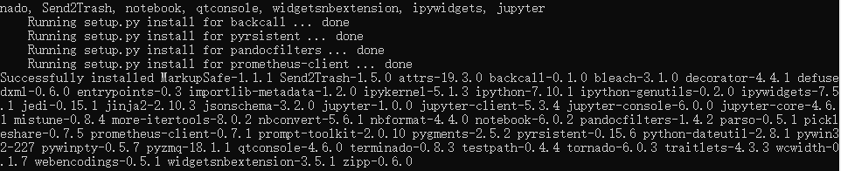
In terminal
upgrade pip
1. pip install --upgrade pip
Install Jupyter Notebook
2. pip install Jupyter
Successfully installed

Slide 3
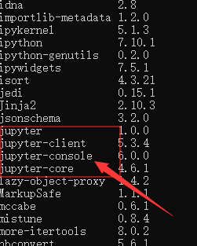
Show the list of packages
3. pip list

Slide 4
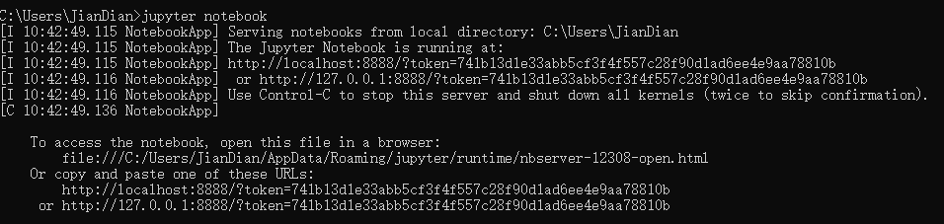
Start Jupyter Notebook
4. jupyter notebook

Slide 5
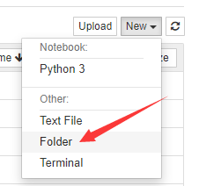
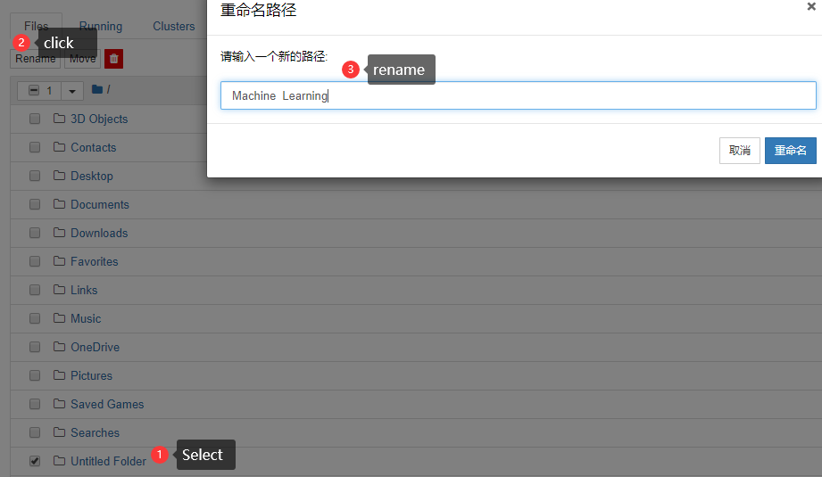
In explorer
Create a Folder named Machine Learning

Slide 6
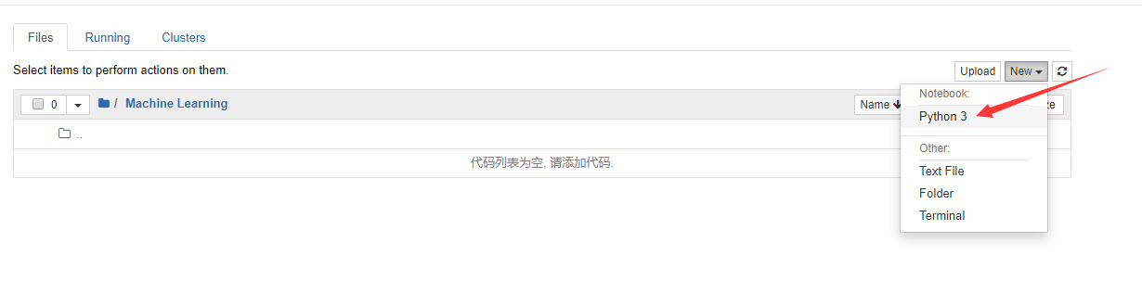
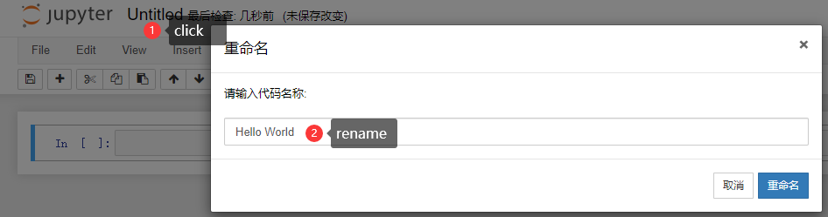
Create a python3 file named Hello World

Slide 7
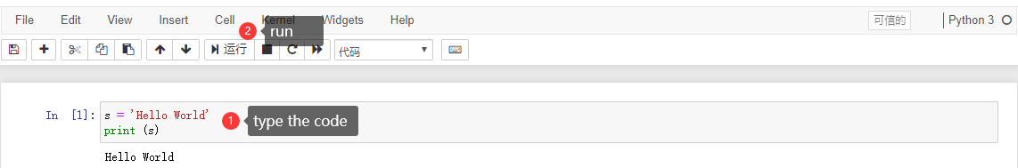
Run the first code and enjoy it.

Slide 8
Install Sklearn CISC7202
by Prof.Weijia Jia (賈維嘉) E11-4007
Email: jiawj@umac.mo

Slide 9
Introduction to Sklearn

Slide 10
Sklearn Library
Sklearn is short for scikit-learn and is a third-party module based on Python. The sklearn library integrates many common machine learning methods. When performing machine learning tasks, you don’t need to implement algorithms by yourself. You only need to call the modules provided in the sklearn library to complete most machine learning tasks.
Sklearn library is based on Numpy, Scipy, and matplotlib, so you need to install these dependencies before you can install sklearn.

Slide 11
Numpy Library
Numpy (short for Numerical Python) is an open source Python scientific computing library. Although the list container and the array module are provided in Python, these structures are not suitable for numerical calculation. Therefore, it is necessary to create common data structures (such as multidimensional arrays, matrices, etc.) and perform common scientific calculations by the Numpy library ( Such as: matrix operation).
Scipy is the basis of the sklearn library, a Python module based on Numpy that integrates multiple mathematical algorithms and functions. Its different submodules have different applications such as integration, interpolation, optimization and signal processing.
Matplotlib is a Numpy-based Python toolkit that provides a number of data drawing tools for drawing statistical graphs and converting large amounts of data into more acceptable charts.

Slide 12
Install Sklearn

Slide 13
Download Package
Download webpage: http://www.lfd.uci.edu/~gohlke/pythonlibs/

Slide 14
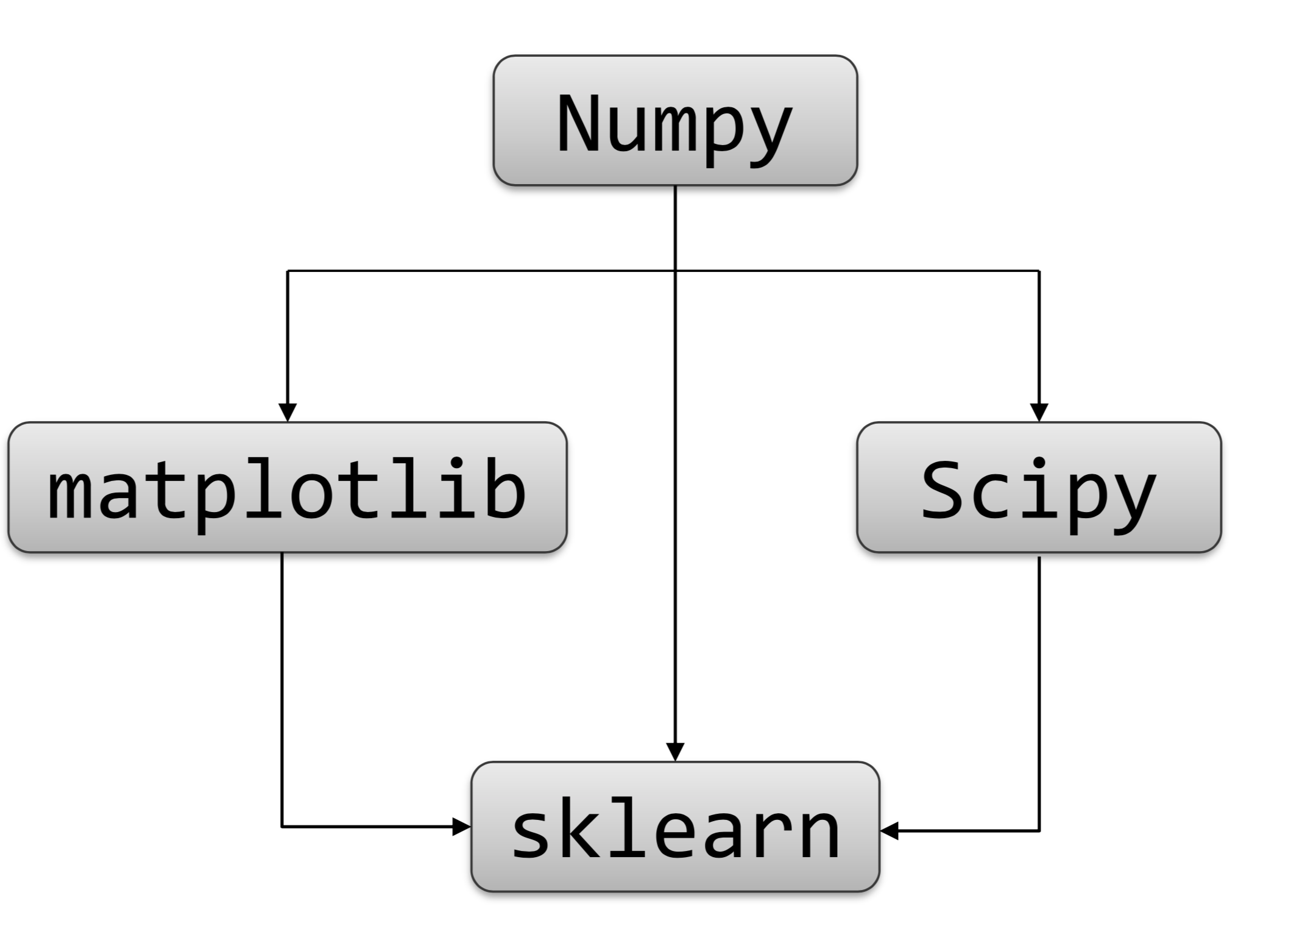
Installation Order
Installion order:
Numpy Library
Scipy Library
Matplotlib Library
Sklearn Library

Slide 15
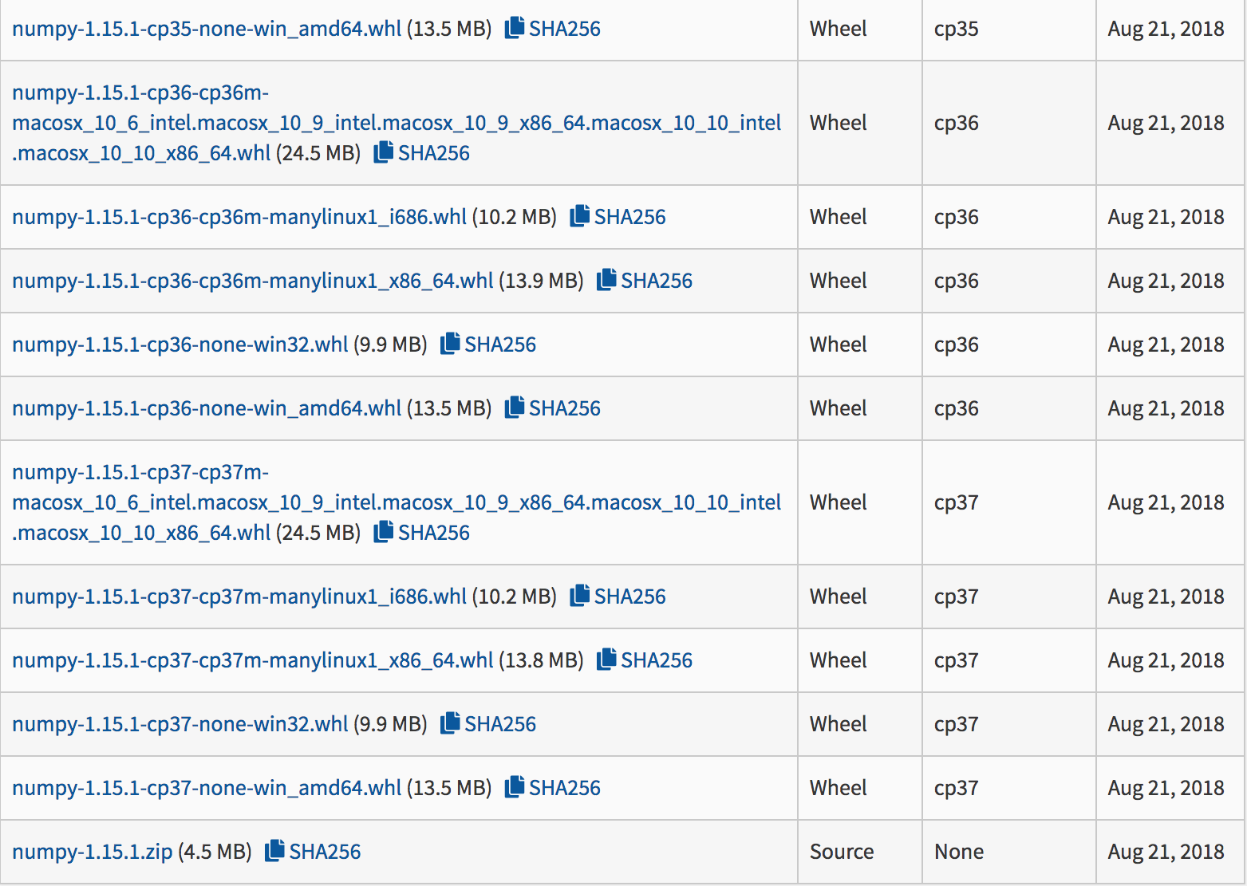
Install Numpy
Visit Numpy‘s download link: https://pypi.org/project/numpy/#files
Download the corresponding file according to the specific version of Python. For example, if this course uses the 64-bit version of Python 3.7, download the win_amd64.whl file.

Slide 16
Install Numpy
Find the path to the downloaded file, open the DOS command line window of Windows, and execute the following command:
pip install numpy-1.15.1-cp37-none-win_amd64.whl

Slide 17
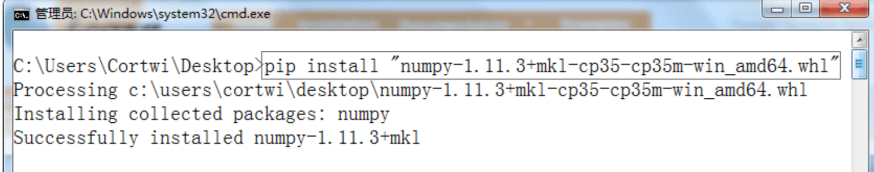
Install Numpy
If no installation errors are prompted, the installation is successful.

Slide 18
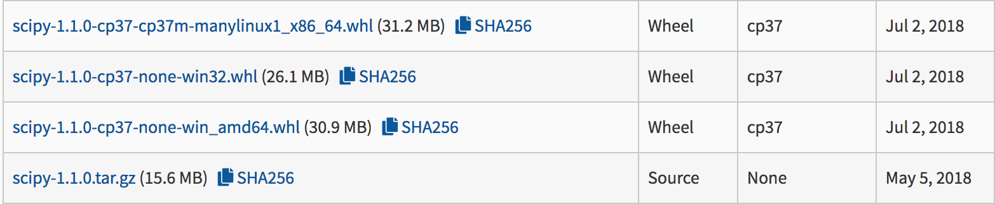
Install Scipy
Visit Scipy‘s download link: https://pypi.org/project/scipy/
Download the corresponding file according to the specific version of Python. Also here you need to download the *win_amd64.whl file in the red box.

Slide 19
Install Scipy
Find the path to the downloaded file, open the DOS command line window for Windows, and use the following command:
pip install scipy-1.1.0-cp37-none-win_amd64.whl

Slide 20
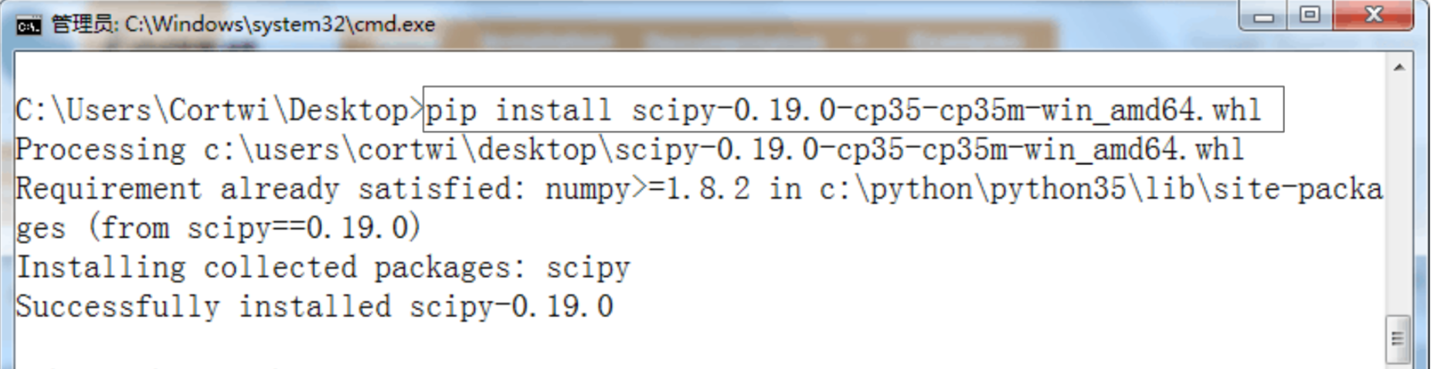
Install Scipy
If no installation errors are prompted, the installation is successful.

Slide 21
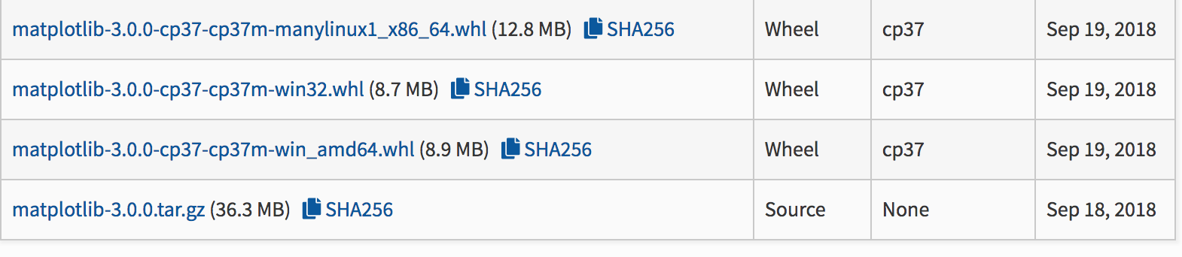
Install Matplotlib
Visit Matplotlib‘s download link: https://pypi.org/project/matplotlib/#files
Download the corresponding file according to the specific version of Python. Also here you need to download the *win_amd64.whl file in the red box.

Slide 22
Install Matplotlib
Find the path to the downloaded file, open the DOS command line window for Windows, and use the following command:
pip install matplotlib-3.0.0-cp37-cp37m-win_amd64.whl

Slide 23
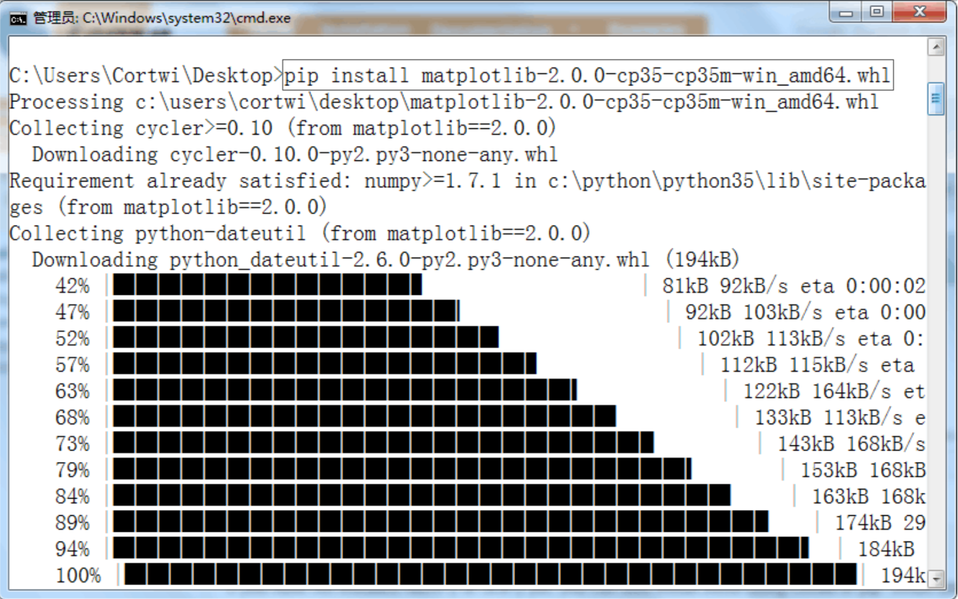
Install Matplotlib

Slide 24
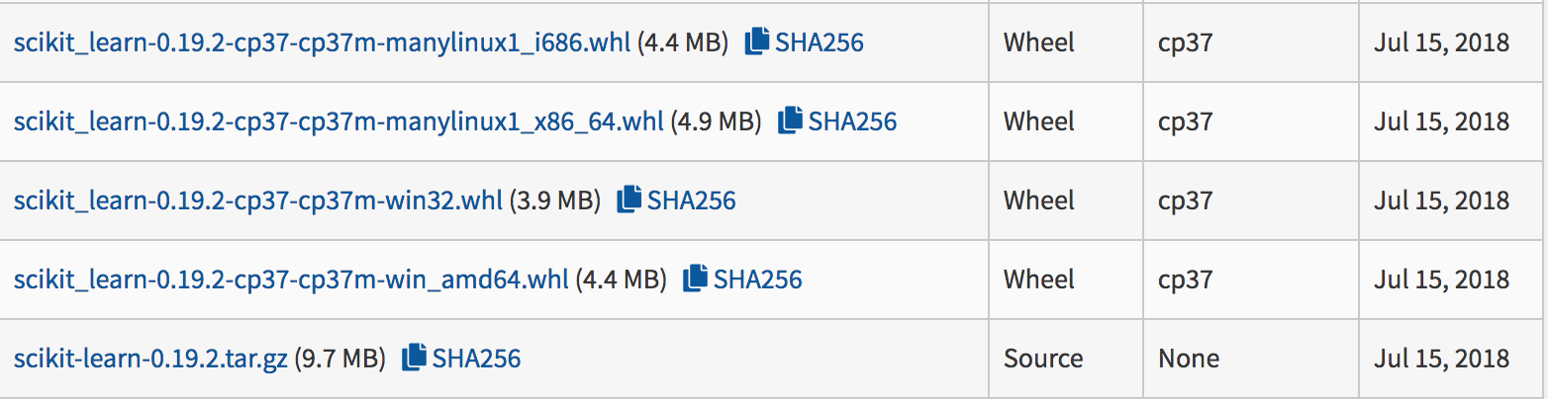
Install Sklearn
Visit Sklearn‘s download link: https://pypi.org/project/scikit-learn/
Download specific version of Python AND *win_amd64.whl file in the red box on the right.

Slide 25
Install Sklearn
Find the path to the downloaded file, open the DOS command line window for Windows, and use the following command:
pip install scikit_learn-0.19.2-cp37-cp37m-win_amd64.whl

Slide 26
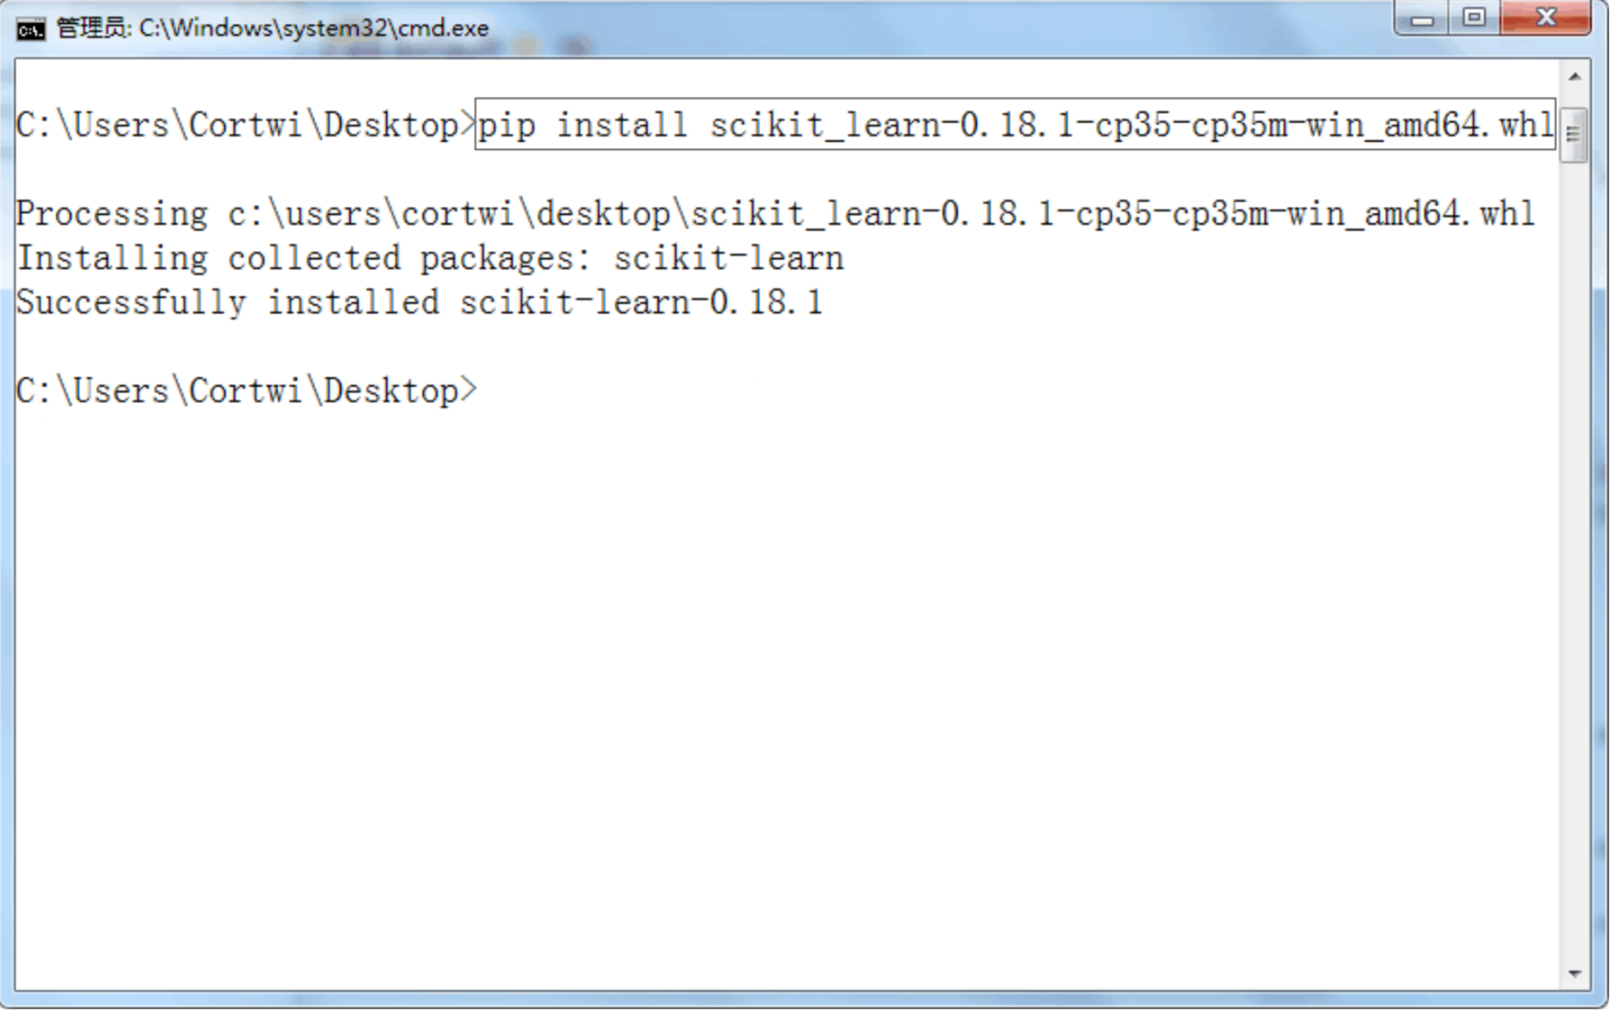
Install Sklearn

Slide 27
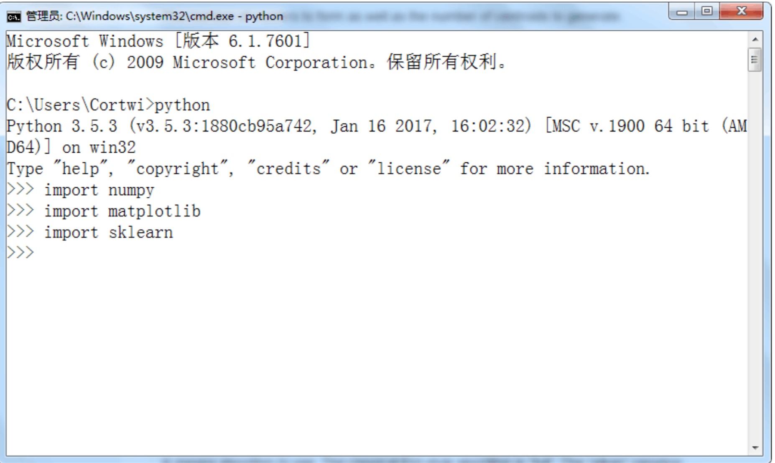
Test

